Slide 1


Caloric & Macro
Nutritional Tracker & Calculator 00

Slide 2
Humber College
Caloric + Macro Nutritional Calculator
Joshua Esemogie n01470636 Kirill Tsybulka n01561393 Roger Paredes n01602284
Pelumi Owoshagba n01574587
May – Aug 2024

Slide 3




1. Team Introduction
Joshua Esemogie, Tech Lead
Roger Paredes, Developer
Kirill Tsybulka, Developer
Pelumi Owoshagba, Developer/Tester
3

Slide 4


2. Introduction
Purpose: To engage users, guide them, and support them in their fitness journey.
Goal: Fill a crucial gap in the fitness and nutrition market by offering accurate, personalized, and actionable nutritional guidance.
4

Slide 5
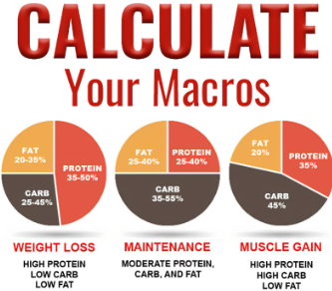
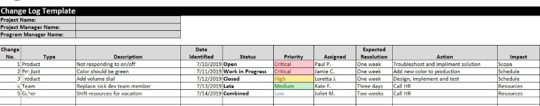
3. Project Description
Caloric + Macro Nutritional Calculator:
Based on individual customer needs.
Users input their stats: weight, height, age, activity level, and desired objective.
Provides required calories and macro nutritional distribution to achieve their objective.
Optional Features:
User accounts for logging progress.
Progress tracking over time
5

Slide 6
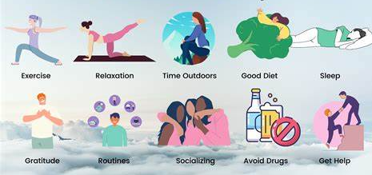

4. Project Business Case: Consumer Demand
Market Insights
High Demand: Increasing prioritization of health and wellness.
Challenges: Many individuals lack accurate information and personalized guidance
6

Slide 7

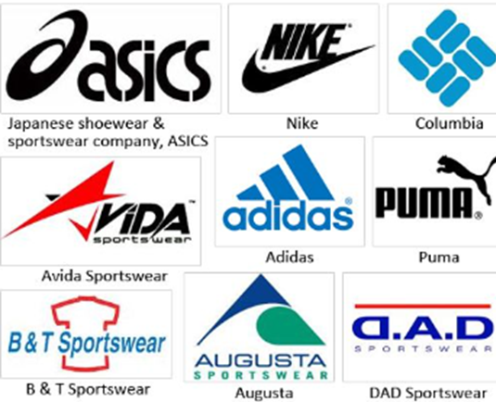

5. Project Business Case: Target Audience
Who Will Benefit
Primary Users: Fitness enthusiasts, athletes, and individuals focused on health.
Professionals: Personal trainers, nutritionists, and fitness industry professionals
Ideal For:
Gyms
Protein supplement companies
Sports brands
7

Slide 8




6. Project Business Case: Competitive Advantage
Unique Selling Points
Personalization: Accurate recommendations tailored to individual needs.
User Experience: Intuitive interface and easy-to-use features.
Progress Tracking: Optional feature for enhanced engagement.
Continuous Improvement: Regular updates based on user feedback and advances in fitness and nutrition.
8

Slide 9

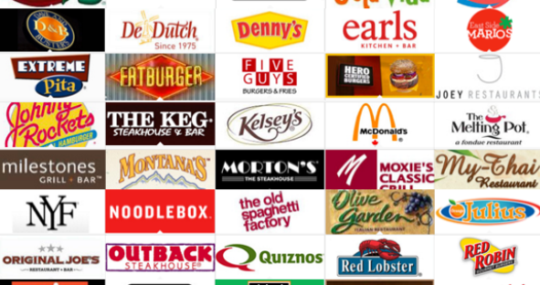
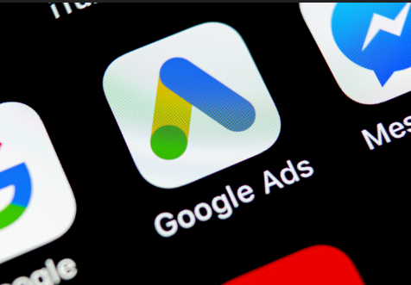
7. Project Business Case: Monetization Strategy
Revenue Generation
Partnerships: Collaborate with fitness or food brands for advertising or affiliate marketing.
Advertising: Implement Google Ads and Network Ads once user base is established.
9

Slide 10
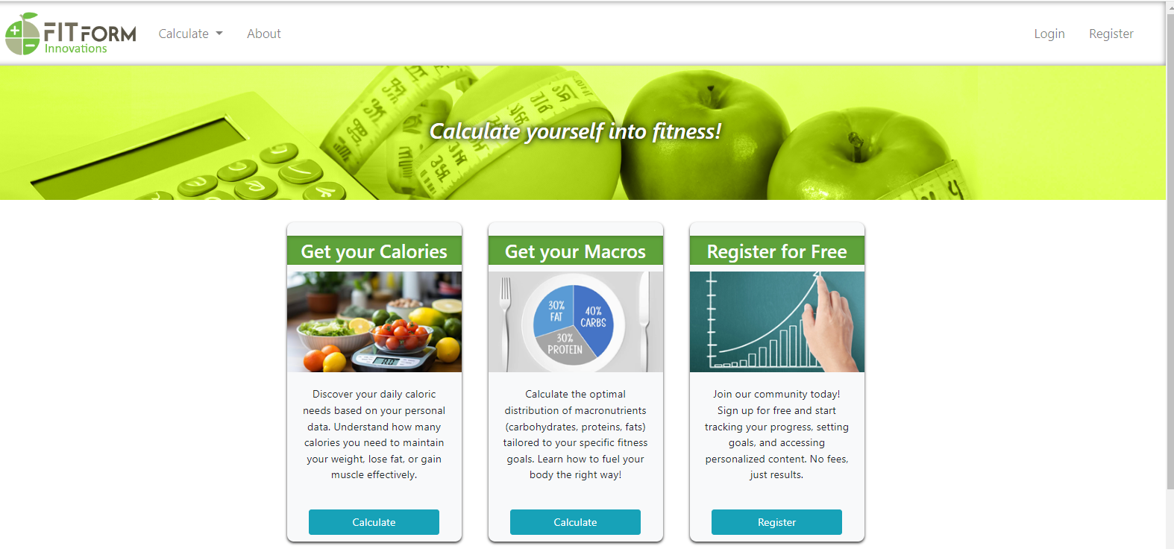
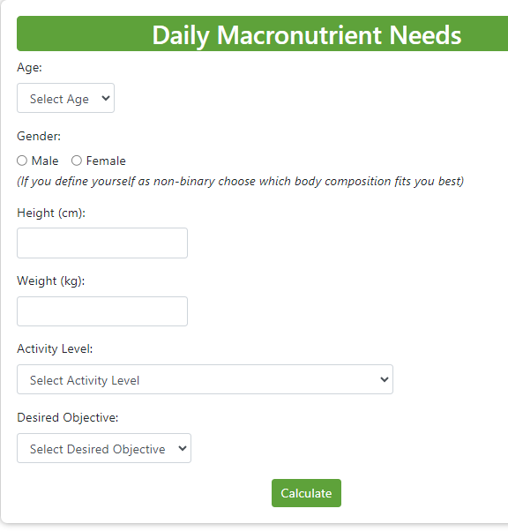
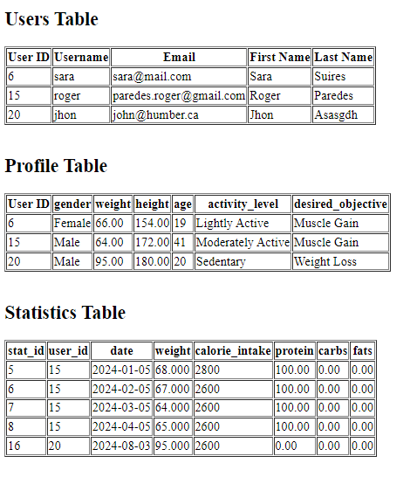
8. Demonstration
Live Demo
10

Slide 11
Questions?

Slide 12
Thank you!

